Slide 1
PART 5 Working with Test Documentation

Slide 2
Agenda

Slide 3
II. Writing and Tracking Test Cases
1. The Goals of Test Case Planning
2. Test Case Planning Overview
3. Test Case Organization and Tracking

Slide 4
II. Writing and Tracking Test Cases
The Goals of Test Case Planning
  Organization
  Repeatability
  Tracking
  Proof of testing (or not testing)
NOTE:
Don't confuse test case planning with the identification of test cases that you learned in Part II, "Testing Fundamentals." Those chapters taught you how to test and how to select test cases, similar to teaching a programmer how to program in a specific language. Test case planning is the next step up and is similar to a programmer learning how to perform high-level design and properly document his work.

Slide 5
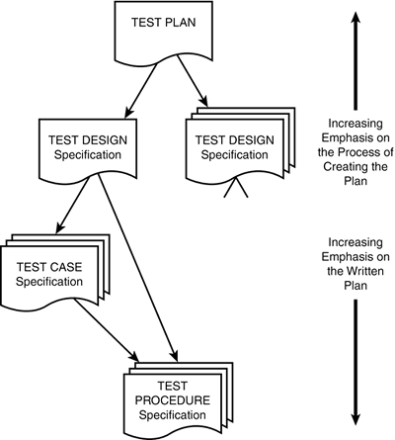
II. Writing and Tracking Test Cases
2. Test Case Planning Overview

Slide 6
II. Writing and Tracking Test Cases
2. Test Case Planning Overview
  Test Design
  Test Cases
  Test Procedures

Slide 7
II. Writing and Tracking Test Cases
2. Test Case Planning Overview
Test Design
IEEE 829 states that the test design specification "refines the test approach [defined in the test plan] and identifies the features to be covered by the design and its associated tests. It also identifies the test cases and test procedures, if any, required to accomplish the testing and specifies the feature pass/fail criteria."

Slide 8
II. Writing and Tracking Test Cases
2. Test Case Planning Overview
Test Design
  Identifiers
  Features to be tested
  Approach
  Test case identification
  Pass/fail criteria

Slide 9
II. Writing and Tracking Test Cases
2. Test Case Planning Overview
Test Case
IEEE 829 states that the test case specification "documents the actual values used for input along with the anticipated outputs. A test case also identifies any constraints on the test procedure resulting from use of that specific test case."

Slide 10
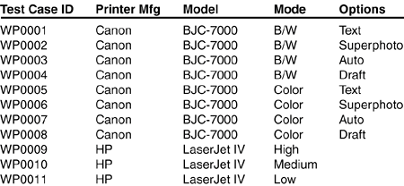
II. Writing and Tracking Test Cases
2. Test Case Planning Overview
Test Cases
  Identifiers
  Test item
  Input specification
  Output specification
  Environmental needs
  Special procedural requirements
  Intercase dependencies.

Slide 11
II. Writing and Tracking Test Cases
2. Test Case Planning Overview
Test Procedures
IEEE 829 states that the test procedure specification "identifies all the steps required to operate the system and exercise the specified test cases in order to implement the associated test design.“
  Identifier
  Purpose
  Special requirements
  Procedure steps

Slide 12
II. Writing and Tracking Test Cases
2. Test Case Planning Overview
Test Procedures steps
  Log
  Setup
  Start
  Procedure
  Measure
  Shut down
  Restart
  Stop
  Wrap up
  Contingencies

Slide 13
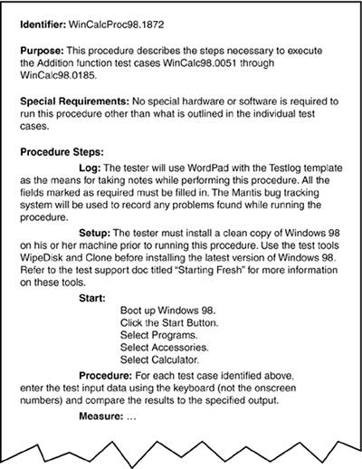

Slide 14
II. Writing and Tracking Test Cases
3. Test Case Organization and Tracking
In your head
Paper/documents
Spreadsheet
Custom database

Slide 15
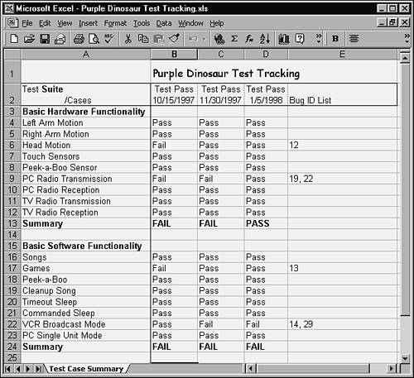

Slide 16
II. Writing and Tracking Test Cases
1. The Goals of Test Case Planning
2. Test Case Planning Overview
3. Test Case Organization and Tracking

